Slide 1
Project
Dr. S.RadhaKrishnan Team
The
By-
Ayesha
Rishvanth
Surya
Jignesh
Veeraju

Slide 2

Talend
Data Integration tool

Slide 3
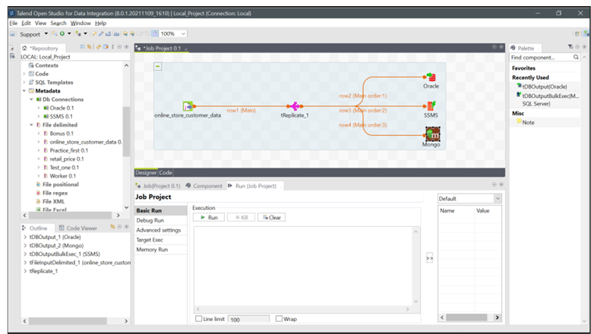
Online_store_customer_data

Slide 4

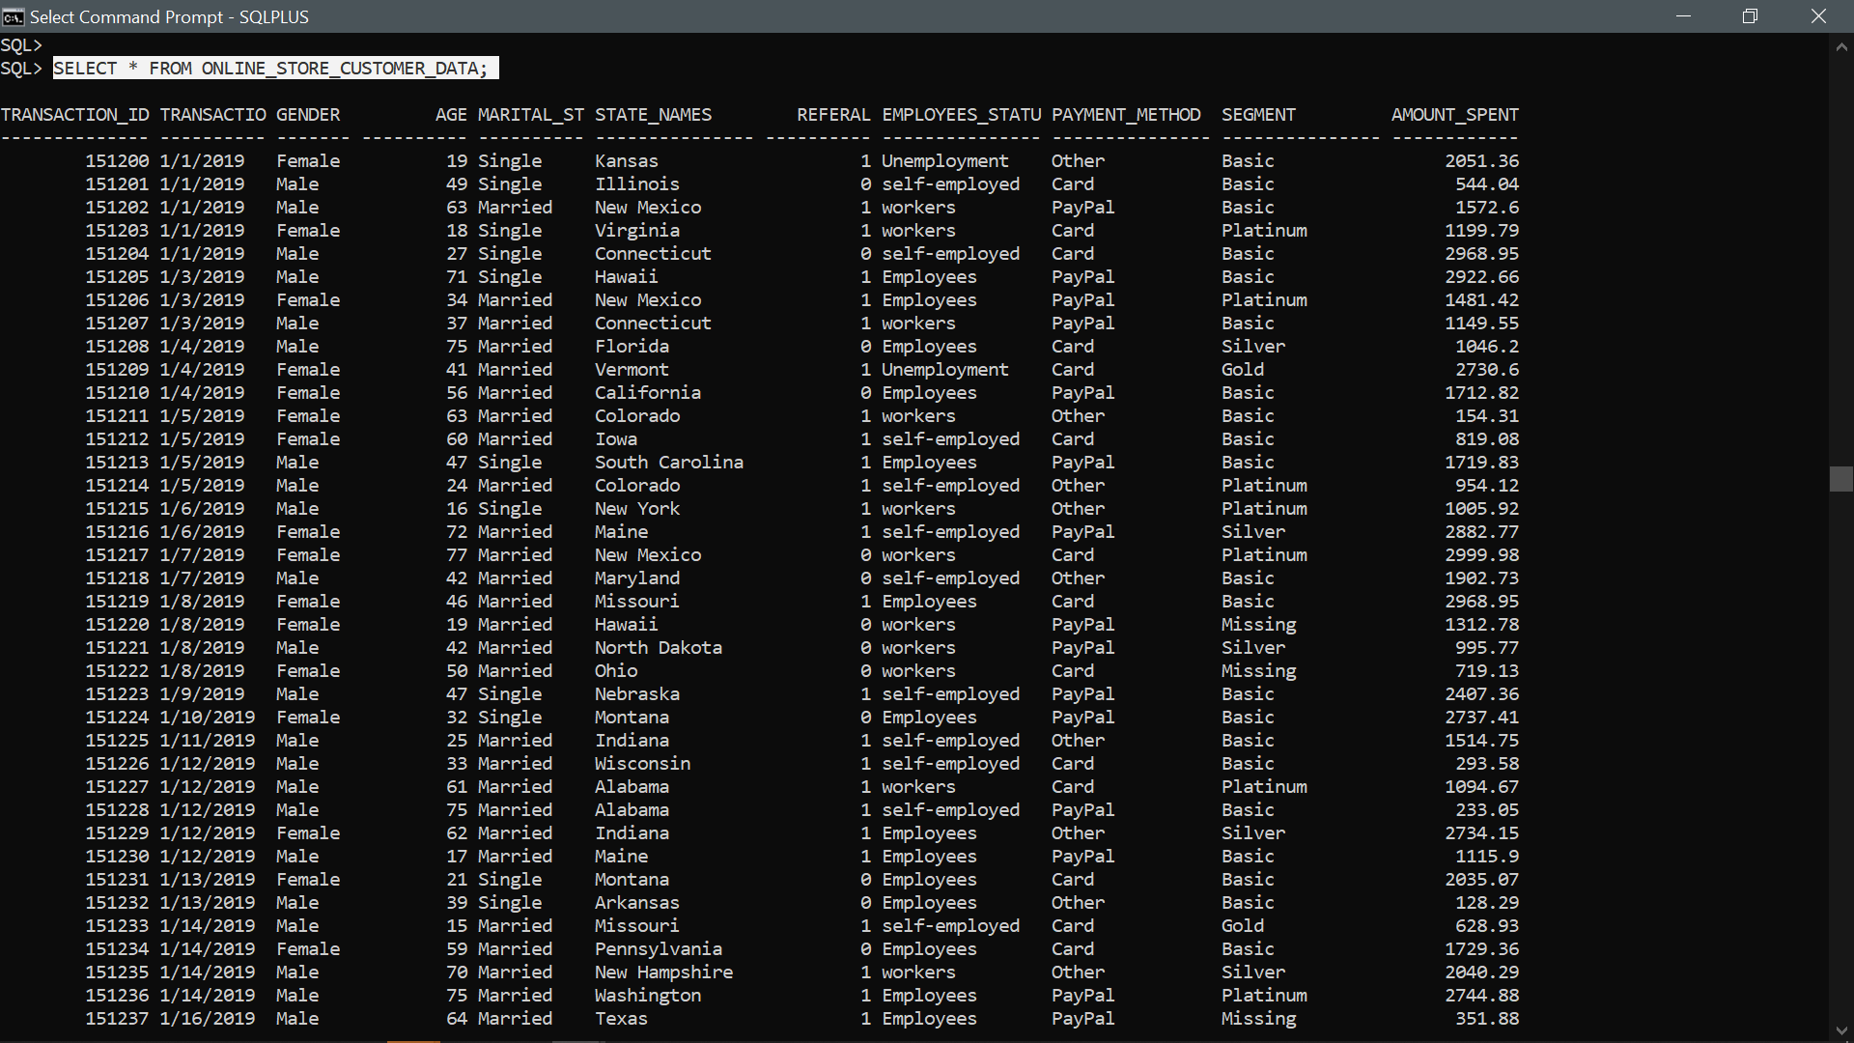
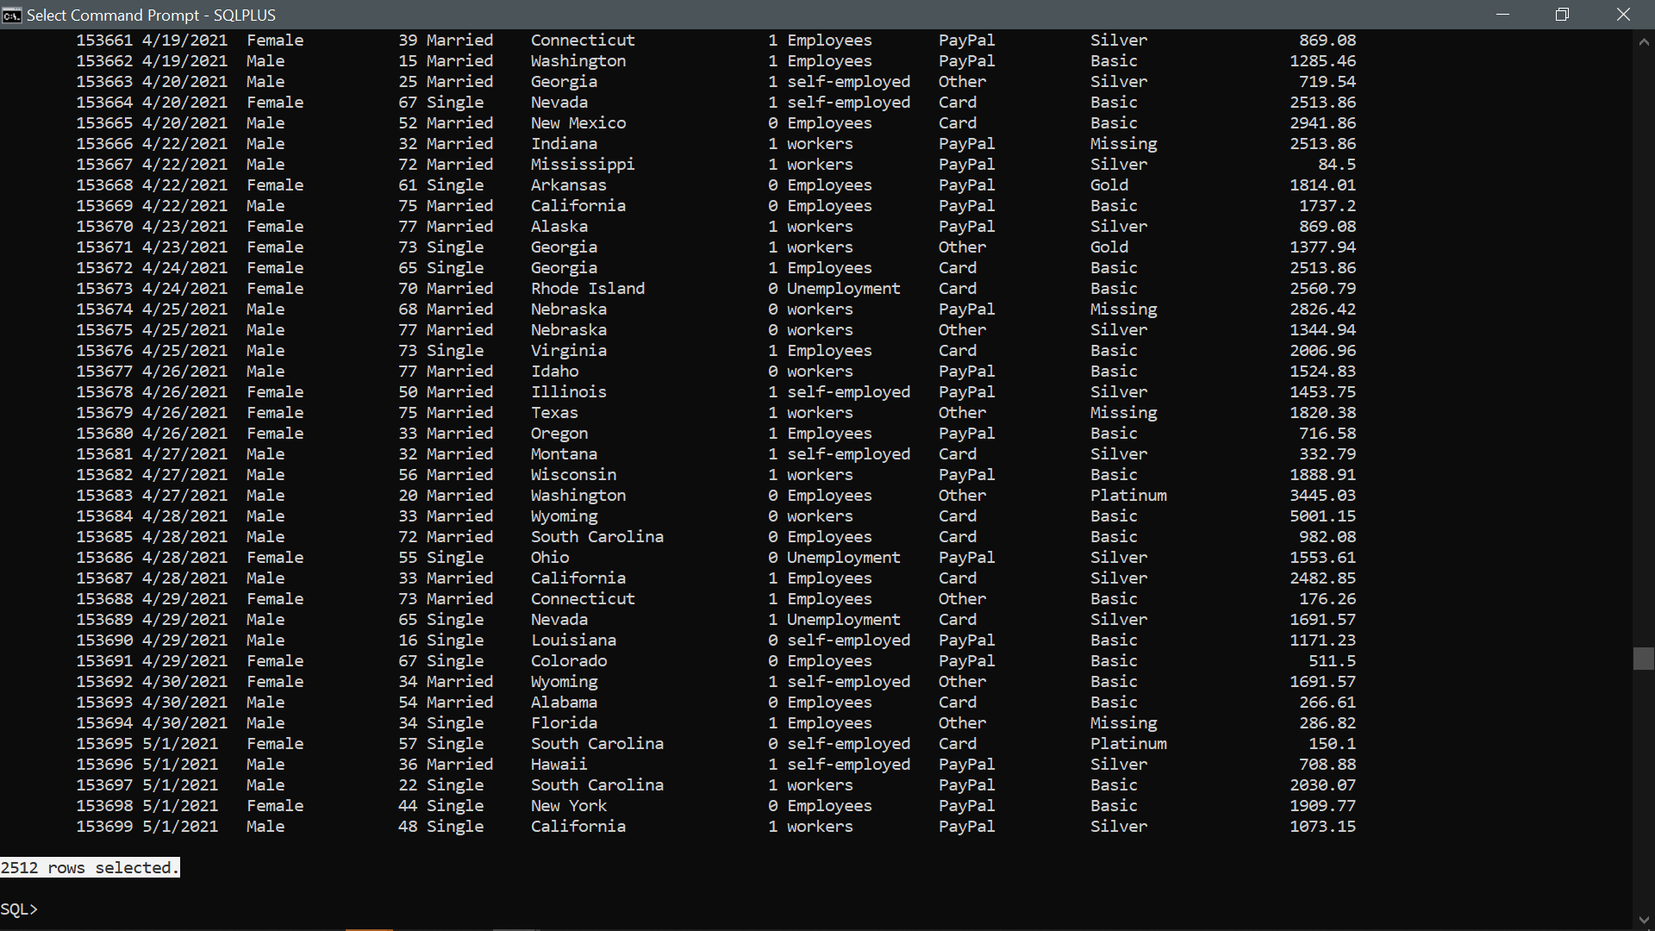
SELECT * FROM ONLINE_STORE_CUSTOMER_DATA;
SQL

Slide 5

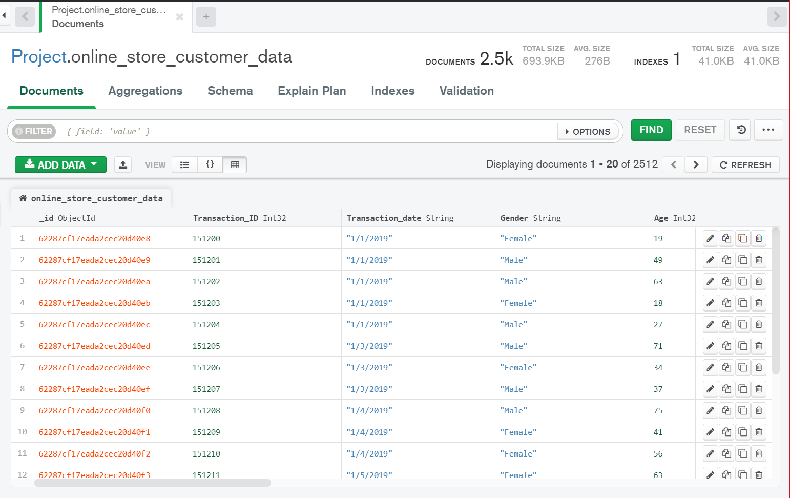
db. online_store_customer_data.find()
Mongo db

Slide 6

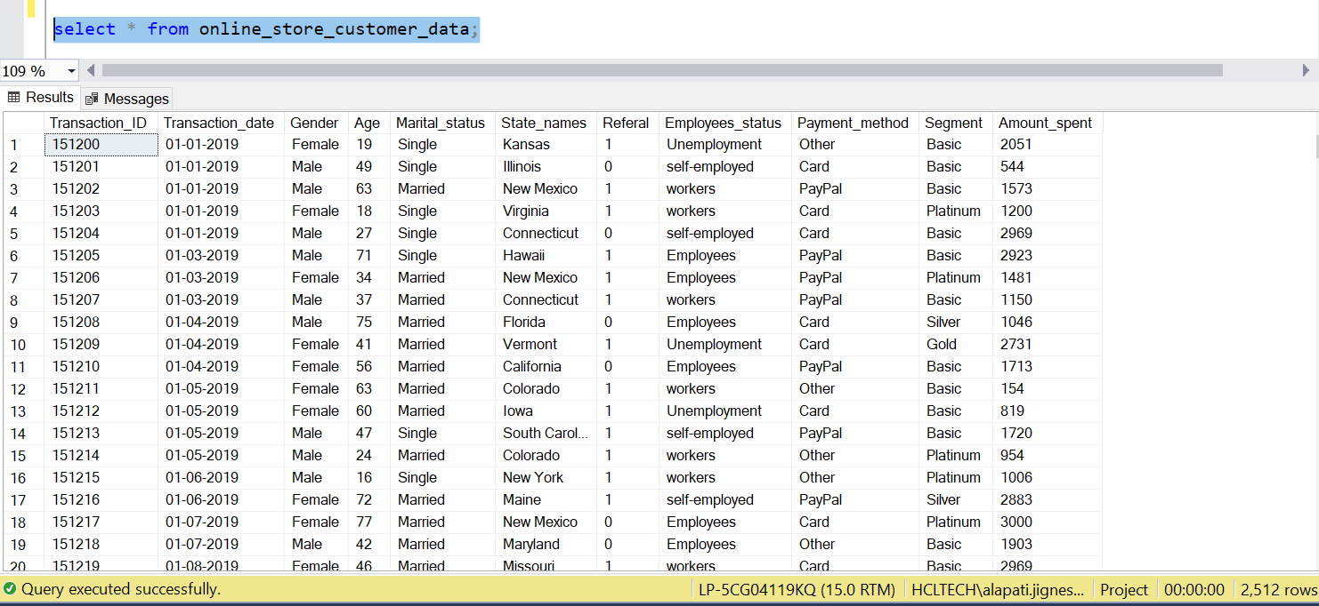
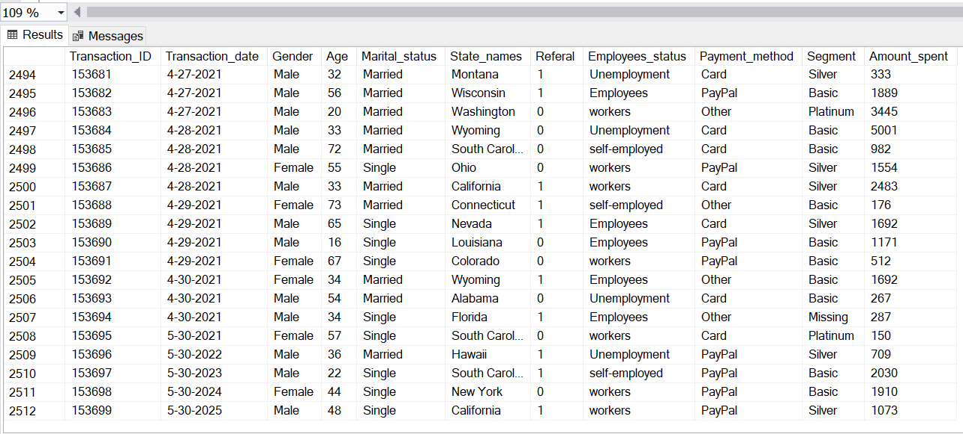
select * from online_store_customer_data;
SSMS

Slide 7

Tableau
Business Intelligence Tool

Slide 8
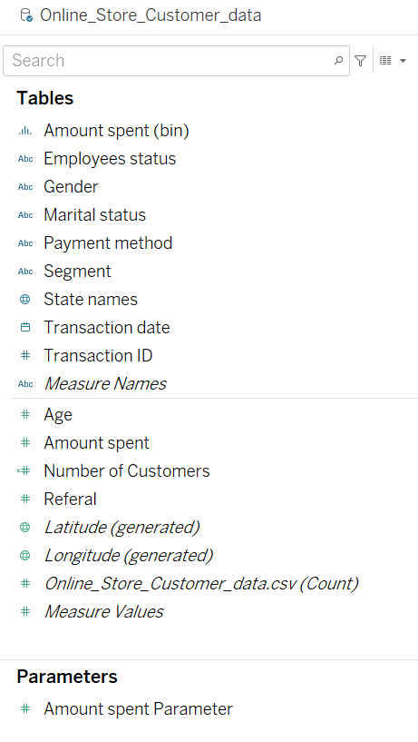
Online Store Customer Data

Slide 9
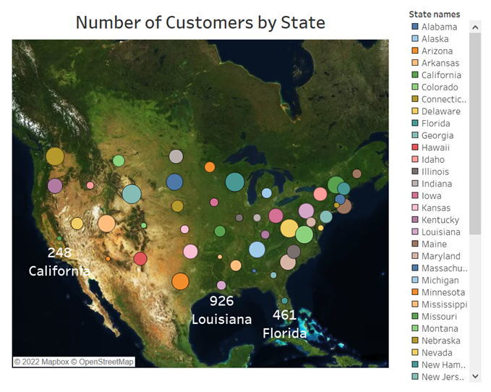
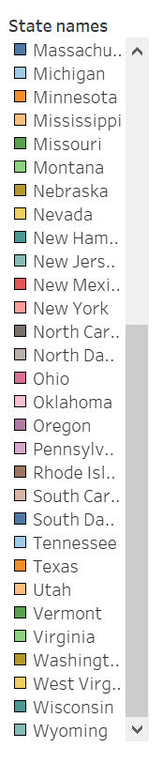
Report – 1

Slide 10
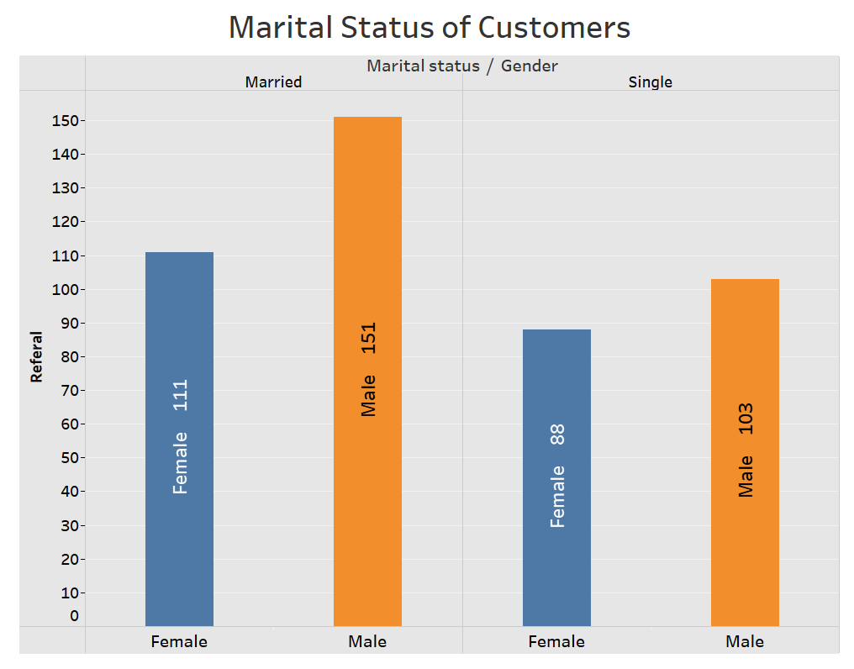
Report – 2

Slide 11
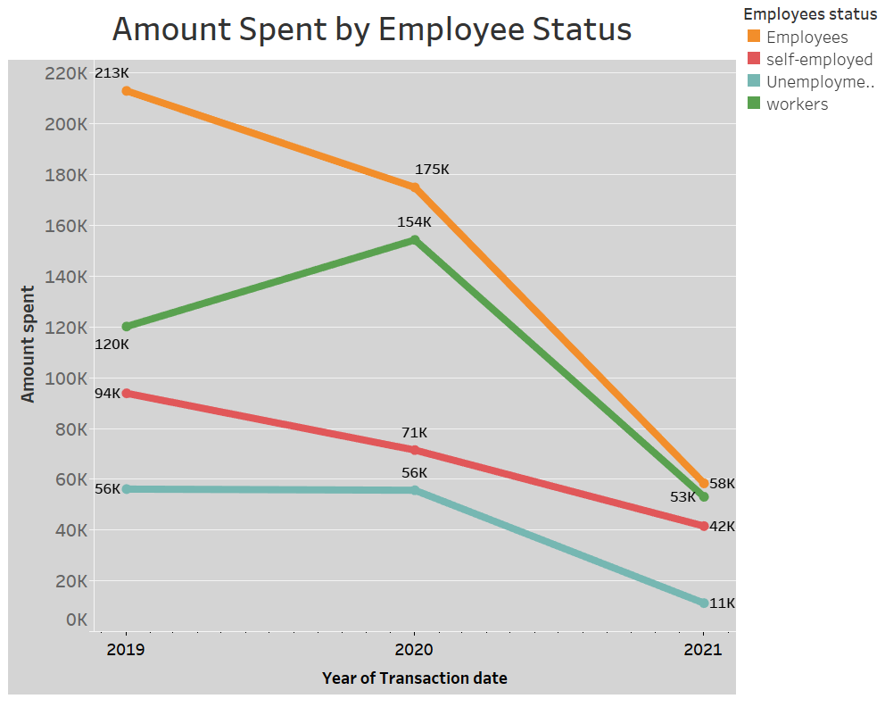
Report – 3

Slide 12

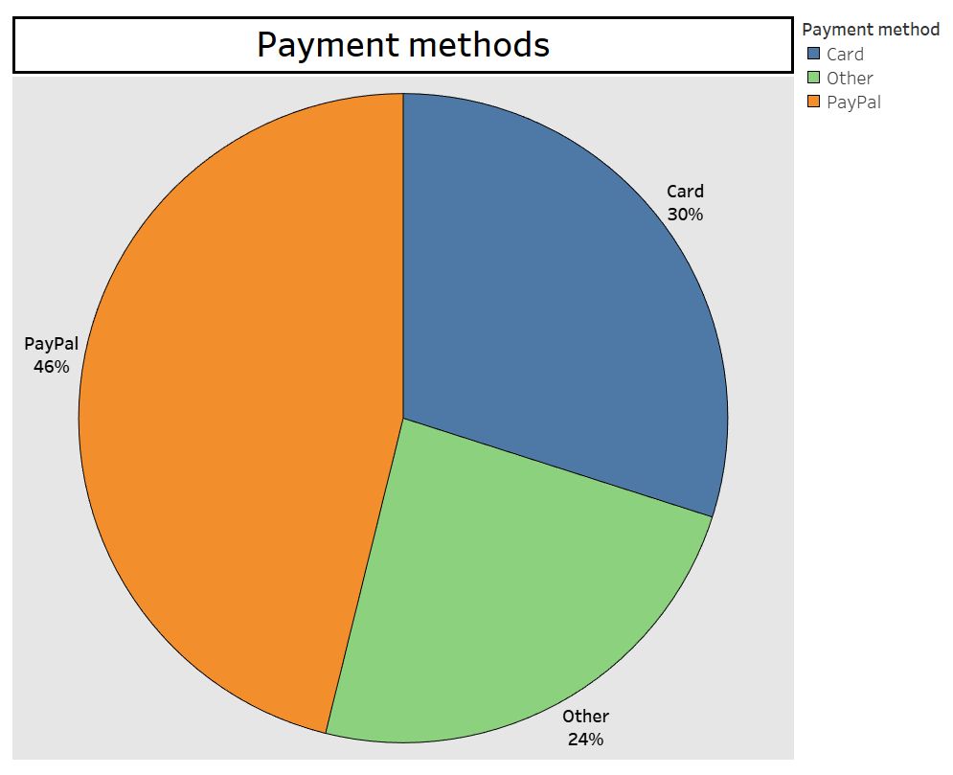

Report – 4

Slide 13
Big Data
Cloudera VM

Slide 14

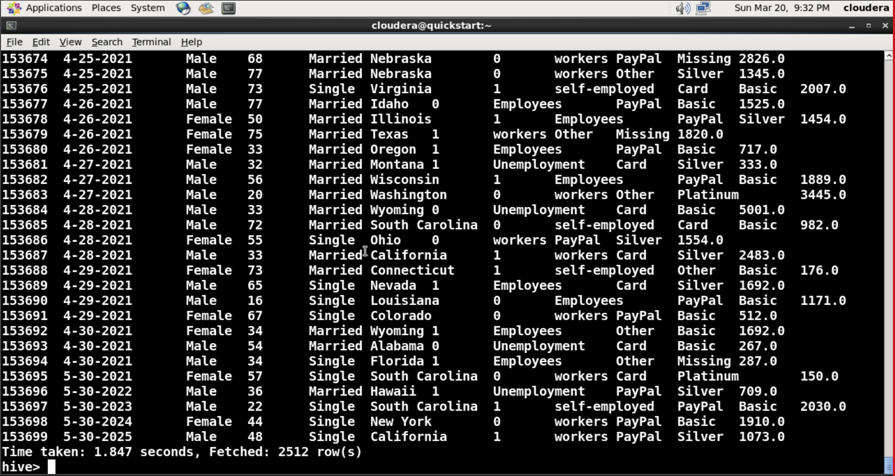
select * from online_store_customer_data
Hive

Slide 15
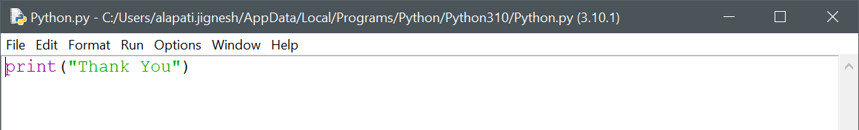
Thank You

